Slide 1
Data Visualization in Python
Data Visualization Concepts
R. Burke Squires
NIAID
Bioinformatics and Computational Biosciences Branch (BCBB)

Slide 2
Get the files…
(http://bioinformatics.niaid.nih.gov)
https://github.com/burkesquires/python_biologist
Download “data_viz_files.zip” in 06_data_viz_python folder
(Click on file, then click on download)
Uncompress
Move to desktop

Slide 3
What is Data Visualization?
“The visual analysis of and communication of data”

Slide 4
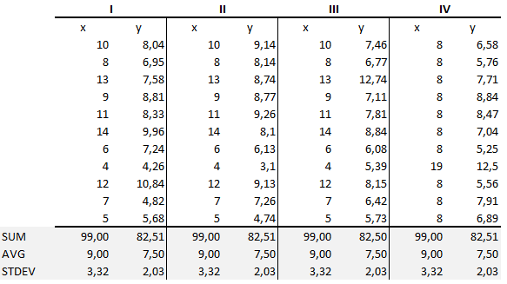
Anscombe’s Quartet
Notes:
http://pbpython.com/visualization-tools-1.html?utm_campaign=Data_Elixir_20&utm_medium=email&utm_source=Data%2BElixir

Slide 5
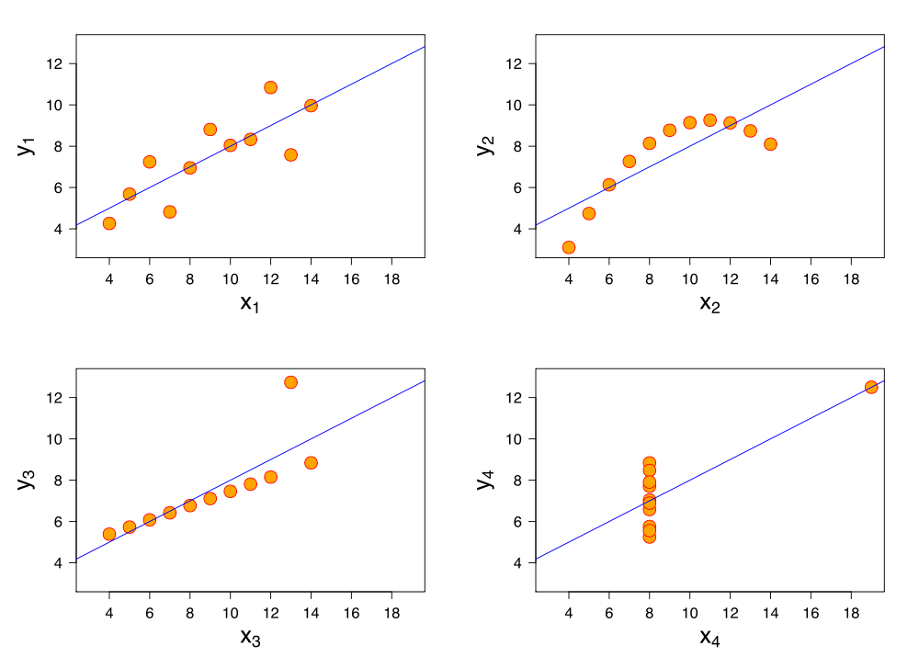
Anscombe’s Quartet
Notes:
Upper-left – randomly distributed
Upper-right – curvilinear linear regression
Lower-left - possible outlier
Lower-right – probable outlier

Slide 6
Objectives
Data Analysis
Understand the data
Derive information from data
Communication
Of information
Of trends
Involves simplification

Slide 7

Napoleon's March by Charles Minard
Minard’s Greatest Hit, c.1869
Notes:
Charles Joseph Minard
Figurative Map of the successive losses in men of the French Army in the Russian campaign 1812-1813.
Drawn by Mr. Minard, Inspector General of Bridges and Roads in retirement. Paris, 20 November 1869. The numbers of men present are represented by the widths of the colored zones in a rate of one millimeter for ten thousand men; these are also written beside the zones. Red designates men moving into Russia, black those on retreat. — The informations used for drawing the map were taken from the works of Messrs. Thiers, de Ségur, de Fezensac, de Chambray and the unpublished diary of Jacob, pharmacist of the Army since 28 October.

Slide 8
Ten-ish Simple Rules / Guidelines
Rule 1: Know Your Audience
Rule 2: Identify Your Message
Rule 3: Adapt the Figure to the Support Medium
Rule 4: Captions Are Not Optional
Rule 5: Do Not Trust the Defaults
Rule 6: Use Color Effectively
Rule 7: Do Not Mislead the Reader
Rule 8: Avoid “Chartjunk”
Rule 9: Message Trumps Beauty
Rule 10: Get the Right Tool
http://journals.plos.org/ploscompbiol/article?id=10.1371/journal.pcbi.1003833

Slide 9
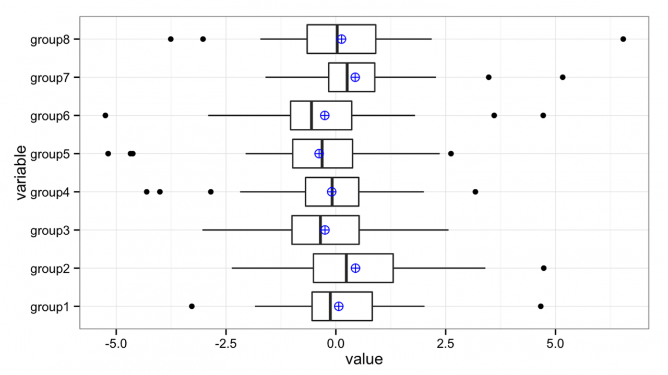
Ten-ish Simple Rules / Guidelines
Know your audience
http://journals.plos.org/ploscompbiol/article?id=10.1371/journal.pcbi.1003833

Slide 10

Ten-ish Simple Rules / Guidelines
Identify your message
http://upload.wikimedia.org/wikipedia/commons/9/9b/Social_Network_Analysis_Visualization.png

Slide 11
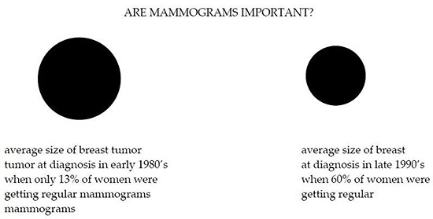
Ten-ish Simple Rules / Guidelines
Captions are not optional
http://ksrowell.com/blog-visualizing-data/2010/12/23/data-visualization-double-take/

Slide 12
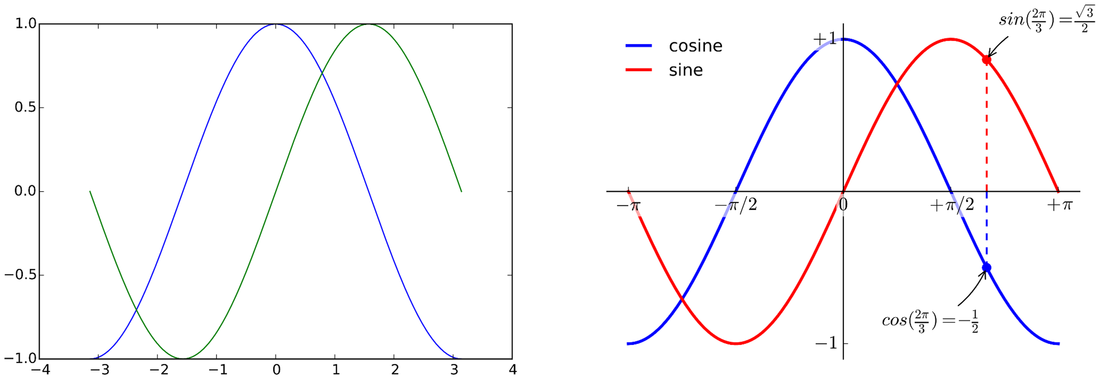
Ten-ish Simple Rules / Guidelines
Do not use the defaults
http://journals.plos.org/ploscompbiol/article?id=10.1371/journal.pcbi.1003833

Slide 13
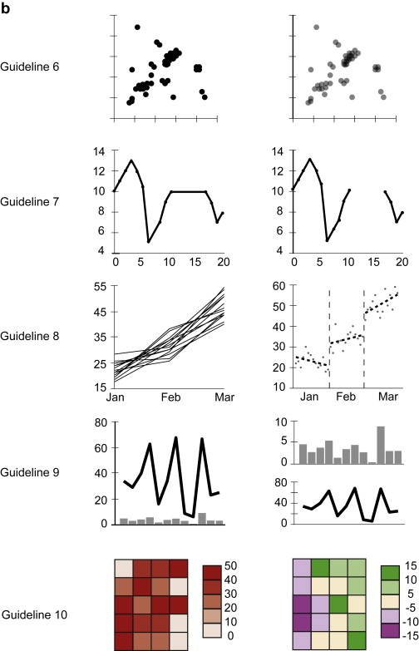
Ten-ish Simple Rules / Guidelines
Use color effectively
http://journals.plos.org/ploscompbiol/article?id=10.1371/journal.pcbi.1003833

Slide 14
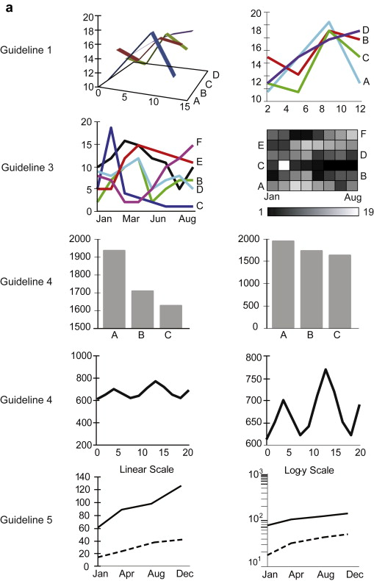
Ten-ish Simple Rules / Guidelines
Do not mislead the reader
http://journals.plos.org/ploscompbiol/article?id=10.1371/journal.pcbi.1003833

Slide 15
Ten-ish Simple Rules / Guidelines
Create the simplest graph
http://journals.plos.org/ploscompbiol/article?id=10.1371/journal.pcbi.1003833

Slide 16
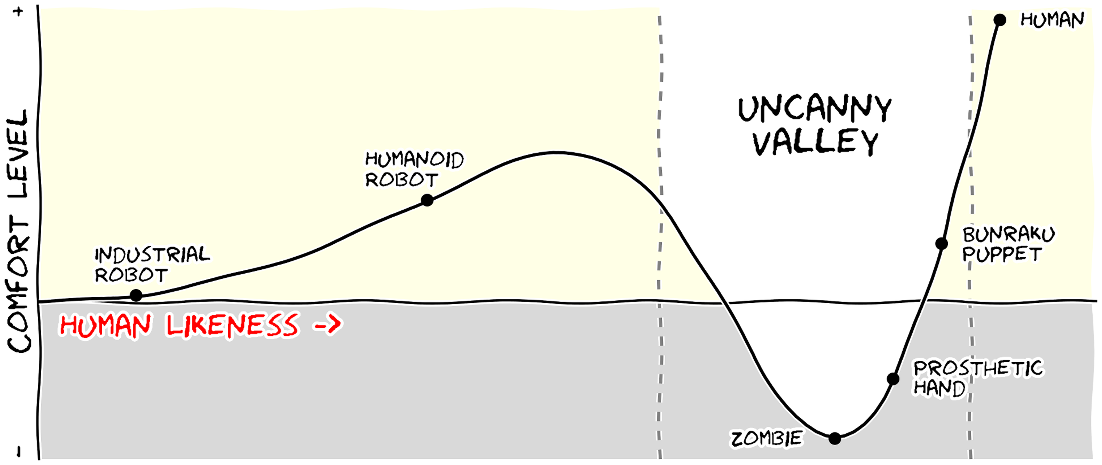
Ten-ish Simple Rules / Guidelines
Message trumps beauty
http://journals.plos.org/ploscompbiol/article?id=10.1371/journal.pcbi.1003833

Slide 17
Ten-ish Simple Rules / Guidelines
Get the right tool…
http://journals.plos.org/ploscompbiol/article?id=10.1371/journal.pcbi.1003833

Slide 18
How Much Data Can You Put In A Chart?

Slide 19
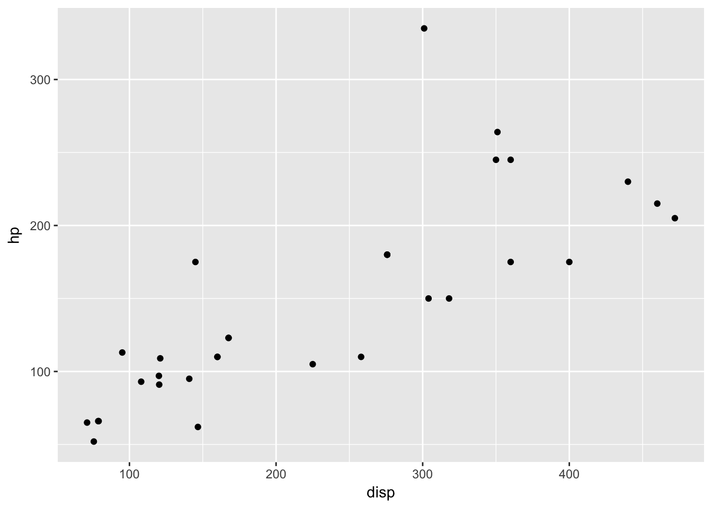
How Much Data Can You Present In A Single Graph? Two Dimensions?
Source: Sean Davis, NCI - https://github.com/seandavi/hour_of_code; NOTE: These are “R” visualizations

Slide 20
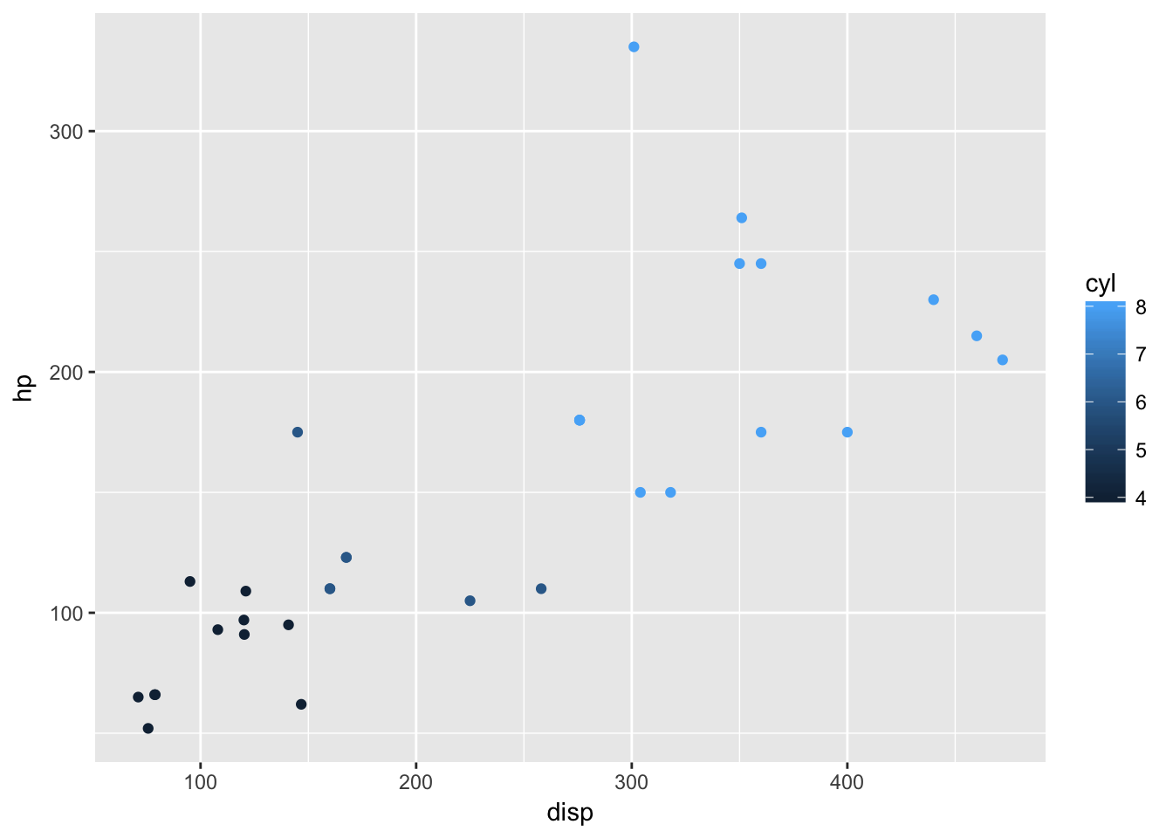
How Much Data Can You Present In A Single Graph? Three Dimensions?

Slide 21
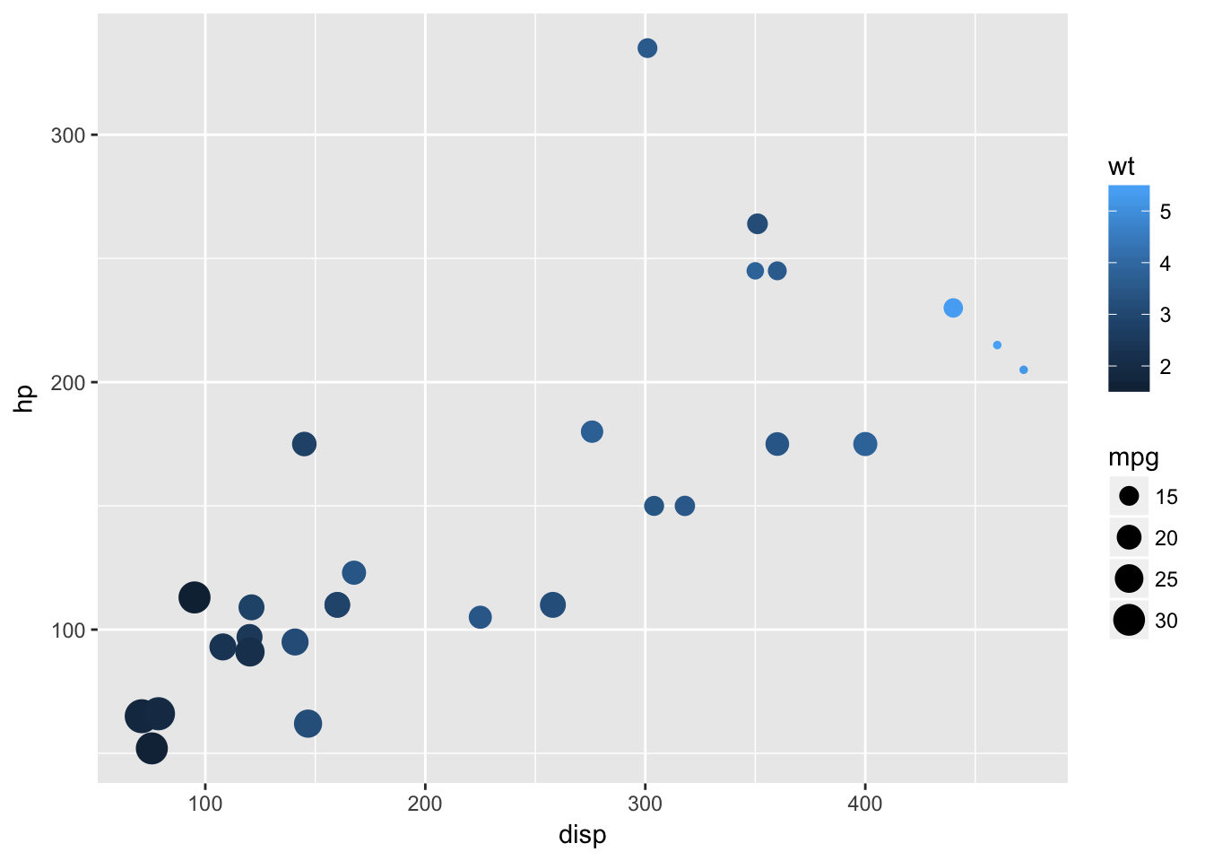
How Much Data Can You Present In A Single Graph? Four Dimensions?

Slide 22
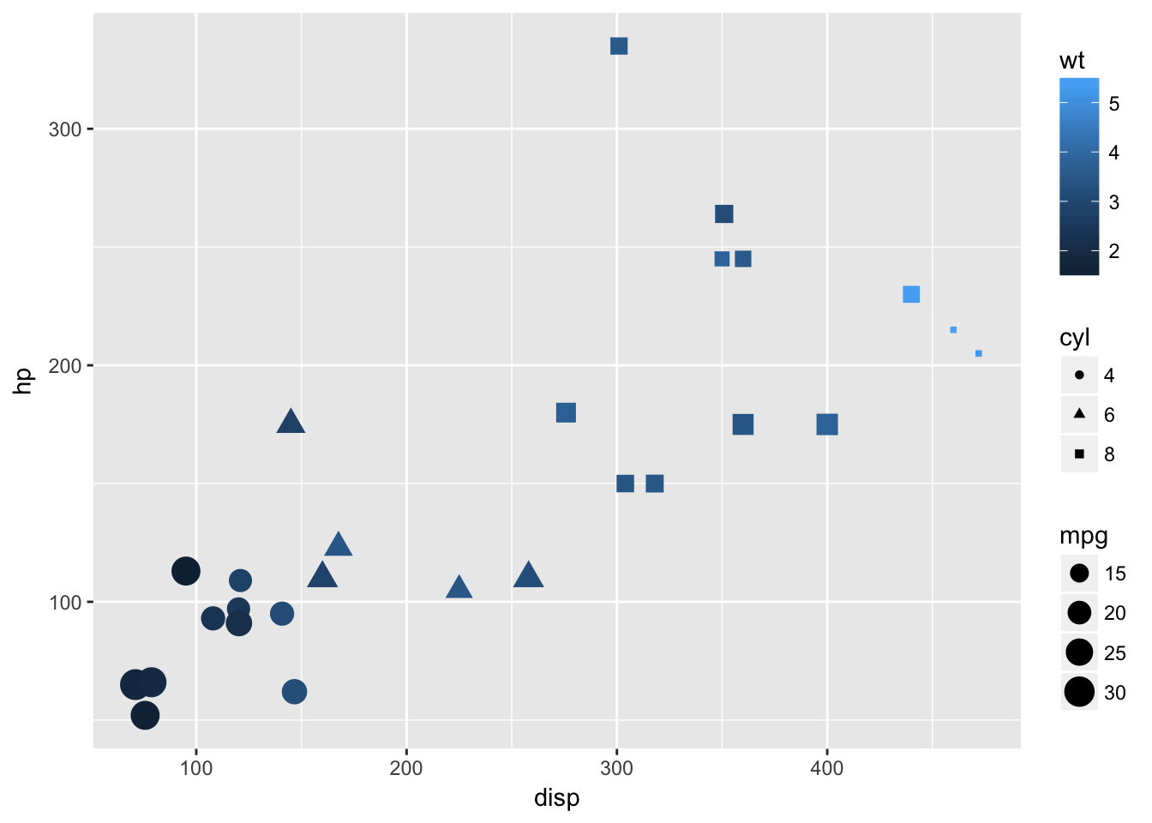
How Much Data Can You Present In A Single Graph? Five Dimensions?

Slide 23
How Do I Know Which Chart To Use?

Slide 24
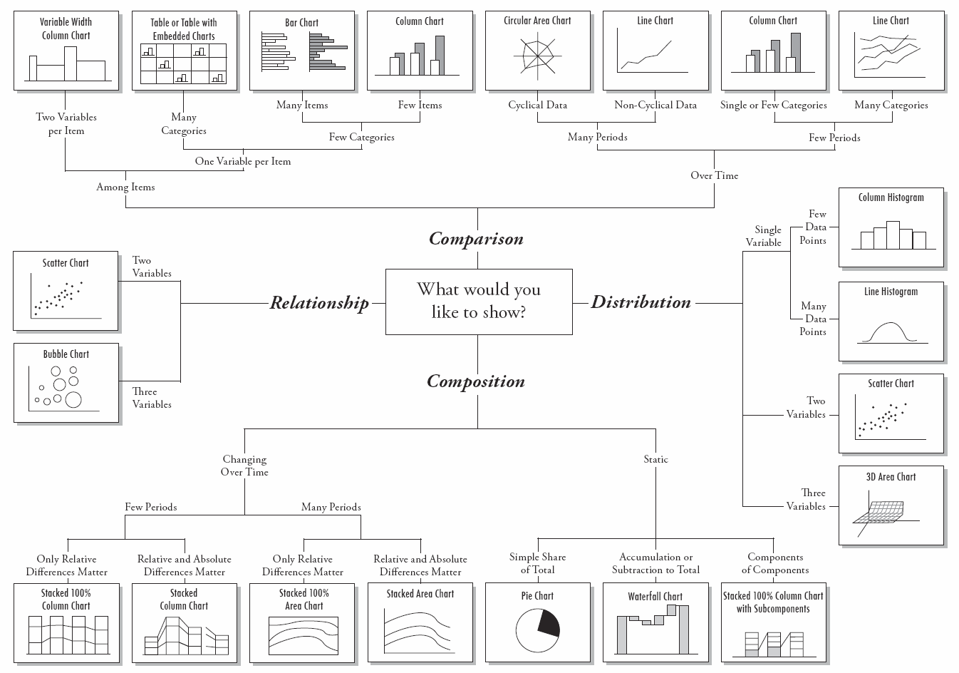
Choose the Right Chart Type for your Data
Source: http://img.labnol.org/di/choosing_a_good_chart2.pdf

Slide 25
Data Visualization
Static data visualization
matplotlib, seaborn, ggpy (ggplot)
Dynamic visualization
Bokeh
Declarative Visualization
Altair
Specialized visualizations
Mapping of geographical data, timelines
3D visualization – Vispy
Notes:
https://speakerdeck.com/wrobstory/python-data-visualization-what-now
Check out
http://newcoder.io/Intro-DataViz/
http://radar.oreilly.com/2013/03/python-data-tools-just-keep-getting-better.html
Network visualization (Cytoscape, Gelphi)

Slide 26
Additional (non-python) Data Visualization Techniques:

Slide 27
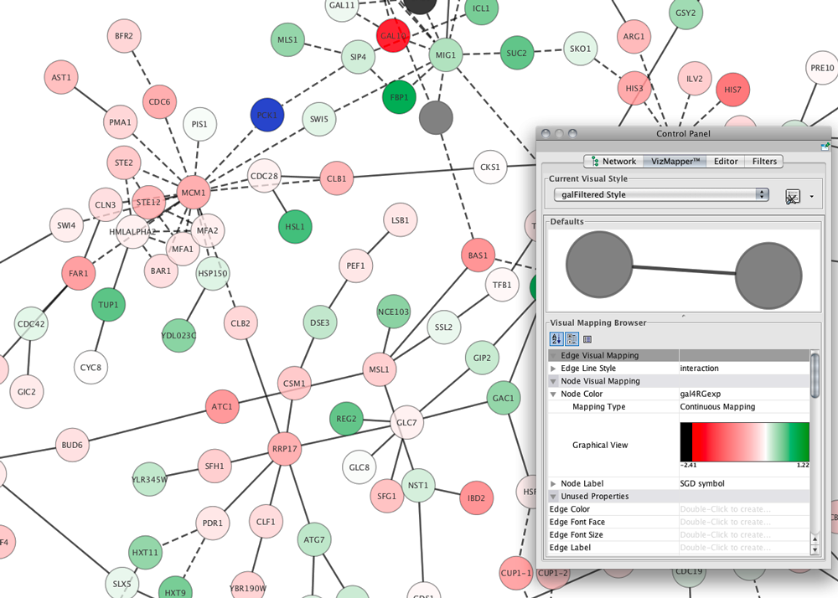
Network Visualization: Cytoscape

Slide 28
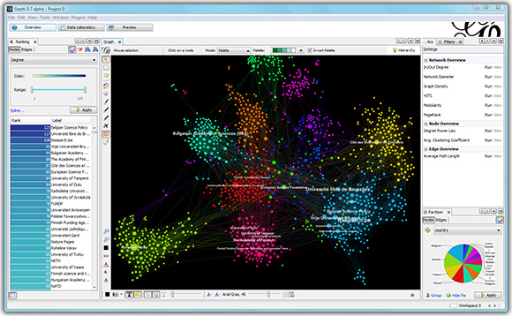
Network Visualization: Gelphi

Slide 29
References
Ten Simple Rules for Better Figures. Nicolas P. Rougier , Michael Droettboom, Philip E. Bourne. PLOS Computational Biology. September 11, 2014

Slide 30
Resources
one-dataset-visualized-25-ways
http://flowingdata.com/2017/01/24/one-dataset-visualized-25-ways/

Slide 31
Resources
Nature Methods: Point of View column
http://blogs.nature.com/methagora/2013/07/data-visualization-points-of-view.html
http://mkweb.bcgsc.ca/pointsofview/
http://www.vanseodesign.com/web-design/gestalt-principles-of-perception/
Course
http://enrico.bertini.io/teaching/
Chart Chooser
http://labs.juiceanalytics.com/chartchooser/

